Slide 1
Software Engineering
Software Process Models

Slide 2
Social Learning Process
Software is embodied knowledge that is initially dispersed, tacit and incomplete.
In order to convert knowledge into software, dialogues are needed between users and designers, between designers and tools to bring knowledge into software.
Software development is essentially an iterative social learning process, and the outcome is “software capital”.

Slide 3
What / who / why is Process Models?
What: Go through a series of predictable steps--- a road map that helps you create a timely, high-quality results.
Who: Software engineers and their managers, clients also. People adapt the process to their needs and follow it.
Why: Provides stability, control, and organization to an activity that can if left uncontrolled, become quite chaotic. However, modern software engineering approaches must be agile and demand ONLY those activities, controls and work products that are appropriate.
What Work products: Programs, documents, and data
What are the steps: The process you adopt depends on the software that you are building. One process might be good for aircraft avionic system, while an entirely different process would be used for website creation.
How to ensure right: A number of software process assessment mechanisms that enable us to determine the maturity of the software process. However, the quality, timeliness and long-term viability of the software are the best indicators of the efficacy of the process you use.

Slide 4
Definition of Software Process
A framework for the activities, actions, and tasks that are required to build high-quality software.
SP defines the approach that is taken as software is engineered.
Is not equal to software engineering, which also encompasses technologies that populate the process– technical methods and automated tools.

Slide 5

A Generic Process Model

Slide 6
A Generic Process Model
As we discussed before, a generic process framework for software engineering defines five framework activities-communication, planning, modeling, construction, and deployment.
In addition, a set of umbrella activities- project tracking and control, risk management, quality assurance, configuration management, technical reviews, and others are applied throughout the process.
Next question is: how the framework activities and the actions and tasks that occur within each activity are organized with respect to sequence and time? See the process flow for answer.

Slide 7

Process Flow

Slide 8
Process Flow
Linear process flow executes each of the five activities in sequence.
An iterative process flow repeats one or more of the activities before proceeding to the next.
An evolutionary process flow executes the activities in a circular manner. Each circuit leads to a more complete version of the software.
A parallel process flow executes one or more activities in parallel with other activities ( modeling for one aspect of the software in parallel with construction of another aspect of the software.

Slide 9
Identifying a Task Set
Before you can proceed with the process model, a key question: what actions are appropriate for a framework activity given the nature of the problem, the characteristics of the people and the stakeholders?
A task set defines the actual work to be done to accomplish the objectives of a software engineering action.
  A list of the task to be accomplished
  A list of the work products to be produced
  A list of the quality assurance filters to be applied

Slide 10
Identifying a Task Set
For example, a small software project requested by one person with simple requirements, the communication activity might encompass little more than a phone all with the stakeholder. Therefore, the only necessary action is phone conversation, the work tasks of this action are:
  1. Make contact with stakeholder via telephone.
  2. Discuss requirements and take notes.
  3. Organize notes into a brief written statement of requirements.
  4. E-mail to stakeholder for review and approval.

Slide 11
Prescriptive Models
Originally proposed to bring order to chaos.
Prescriptive process models advocate an orderly approach to software engineering. However, will some extent of chaos (less rigid) be beneficial to bring some creativity?
That leads to a few questions …
If prescriptive process models strive for structure and order (prescribe a set of process elements and process flow), are they inappropriate for a software world that thrives on change?
Yet, if we reject traditional process models (and the order they imply) and replace them with something less structured, do we make it impossible to achieve coordination and coherence in software work?

Slide 12
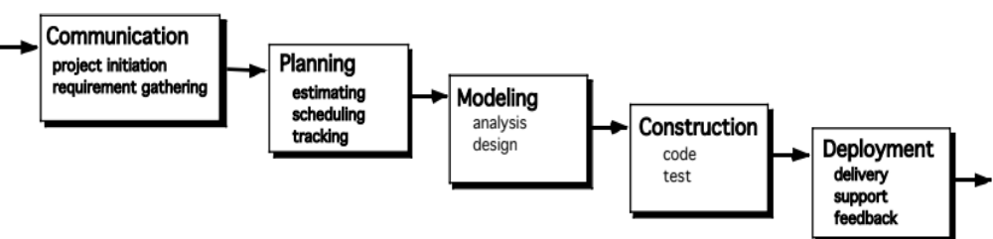
The Waterfall Model
It is the oldest paradigm for SE. When requirements are well defined and reasonably stable, it leads to a linear fashion.
(problems: 1. rarely linear, iteration needed. 2. hard to state all requirements explicitly. Blocking state. 3. code will not be released until very late.)
The classic life cycle suggests a systematic, sequential approach to software development.

Slide 13
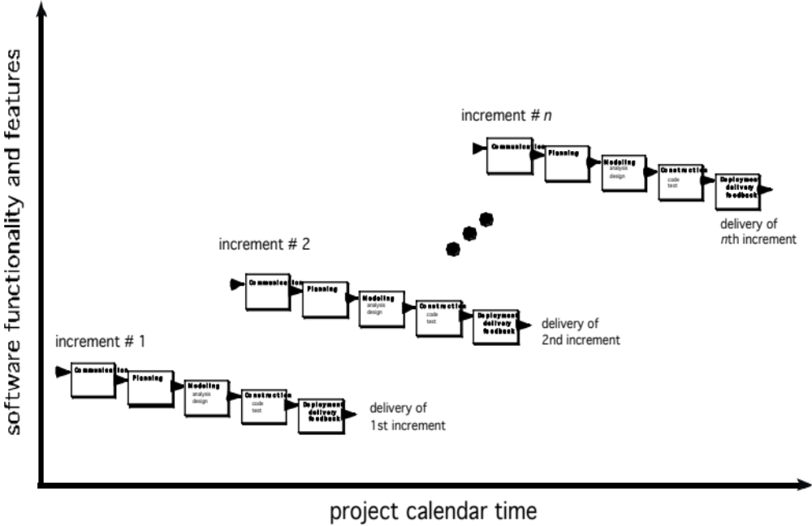
The Incremental Model

Slide 14
The Incremental Model
When initial requirements are reasonably well defined, but the overall scope of the development effort precludes a purely linear process. A compelling need to expand a limited set of new functions to a later system release.
It combines elements of linear and parallel process flows. Each linear sequence produces deliverable increments of the software.
The first increment is often a core product with many supplementary features. Users use it and evaluate it with more modifications to better meet the needs.

Slide 15
The RAD Model
These slides are designed to accompany Software Engineering: A Practitioner’s Approach, 7/e (McGraw-Hill, 2009). Slides copyright 2009 by Roger Pressman.
Rapid Application Development (RAD) is an incremental software process model that emphasizes a short development cycle
If requirements are well understood and project scope is constrained, the RAD process enables a development team to create a fully functional system within a short period of time

Slide 16
RAD
These slides are designed to accompany Software Engineering: A Practitioner’s Approach, 7/e (McGraw-Hill, 2009). Slides copyright 2009 by Roger Pressman.
Drawbacks:
  For large, but scalable projects, RAD requires sufficient human resources to create the right number of RAD teams.
  If developers and customers are not committed to the rapid-fire activities necessary to complete the system in a much abbreviated time frame, RAD project will fail.
  If a system cannot properly be modularized, building the components necessary for RAD will be problematic.

Slide 17
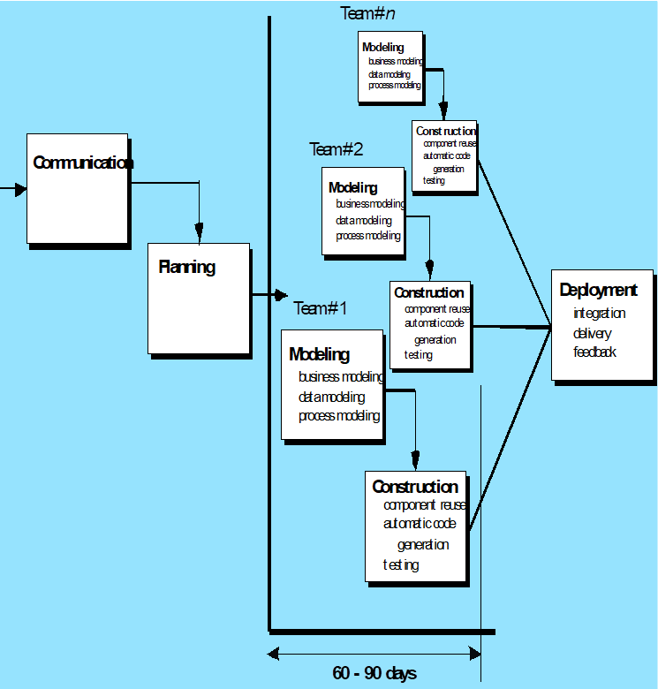
These slides are designed to accompany Software Engineering: A Practitioner’s Approach, 7/e (McGraw-Hill, 2009). Slides copyright 2009 by Roger Pressman.

Slide 18
Evolutionary Models
Software system evolves over time as requirements often change as development proceeds. Thus, a straight line to a complete end product is not possible. However, a limited version must be delivered to meet competitive pressure.
Usually a set of core product or system requirements is well understood, but the details and extension have yet to be defined.
You need a process model that has been explicitly designed to accommodate a product that evolved over time.
It is iterative that enables you to develop increasingly more complete version of the software.
Two types are introduced, namely Prototyping and Spiral models.

Slide 19
Evolutionary Models: Prototyping
When to use: Customer defines a set of general objectives but does not identify detailed requirements for functions and features. Or Developer may be unsure of the efficiency of an algorithm, the form that human computer interaction should take.
What step: Begins with communication by meeting with stakeholders to define the objective, identify whatever requirements are known, outline areas where further definition is mandatory. A quick plan for prototyping and modeling (quick design) occur. Quick design focuses on a representation of those aspects the software that will be visible to end users. ( interface and output). Design leads to the construction of a prototype which will be deployed and evaluated. Stakeholder’s comments will be used to refine requirements.
Both stakeholders and software engineers like the prototyping paradigm. Users get a feel for the actual system, and developers get to build something immediately. However, engineers may make compromises in order to get a prototype working quickly. The less-than-ideal choice may be adopted forever after you get used to it.

Slide 20
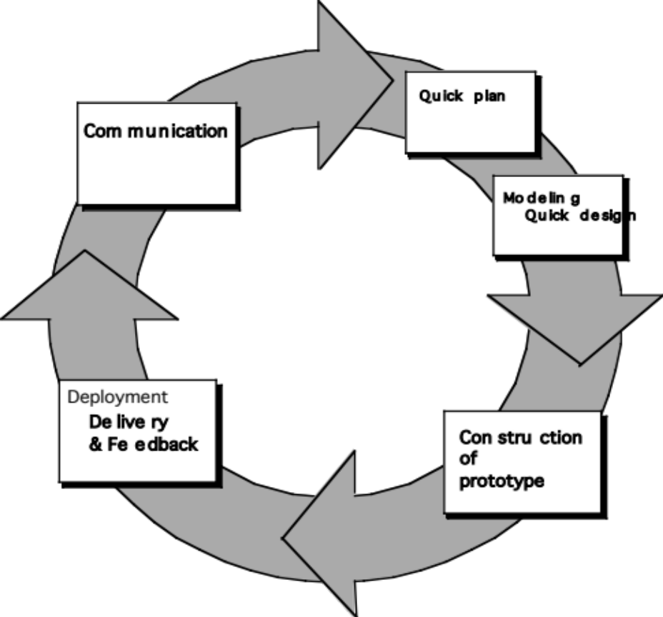
Evolutionary Models: Prototyping
Quick
plan
communication
Modeling
Quick design
Deployment
delivery &
feedback
Construction
of prototype
Construction
of prototype

Slide 21
Evolutionary Models: The Spiral
It couples the iterative nature of prototyping with the controlled and systematic aspects of the waterfall model and is a risk-driven process model generator that is used to guide multi-stakeholder concurrent engineering of software intensive systems.
Two main distinguishing features: one is cyclic approach for incrementally growing a system’s degree of definition and implementation while decreasing its degree of risk. The other is a set of anchor point milestones for ensuring stakeholder commitment to feasible and mutually satisfactory system solutions.
A series of evolutionary releases are delivered. During the early iterations, the release might be a model or prototype. During later iterations, increasingly more complete version of the engineered system are produced.
The first circuit in the clockwise direction might result in the product specification; subsequent passes around the spiral might be used to develop a prototype and then progressively more sophisticated versions of the software. Each pass results in adjustments to the project plan. Cost and schedule are adjusted based on feedback. Also, the number of iterations will be adjusted by project manager.
Good to develop large-scale system as software evolves as the process progresses and risk should be understood and properly reacted to. Prototyping is used to reduce risk.
However, it may be difficult to convince customers that it is controllable as it demands considerable risk assessment expertise.

Slide 22
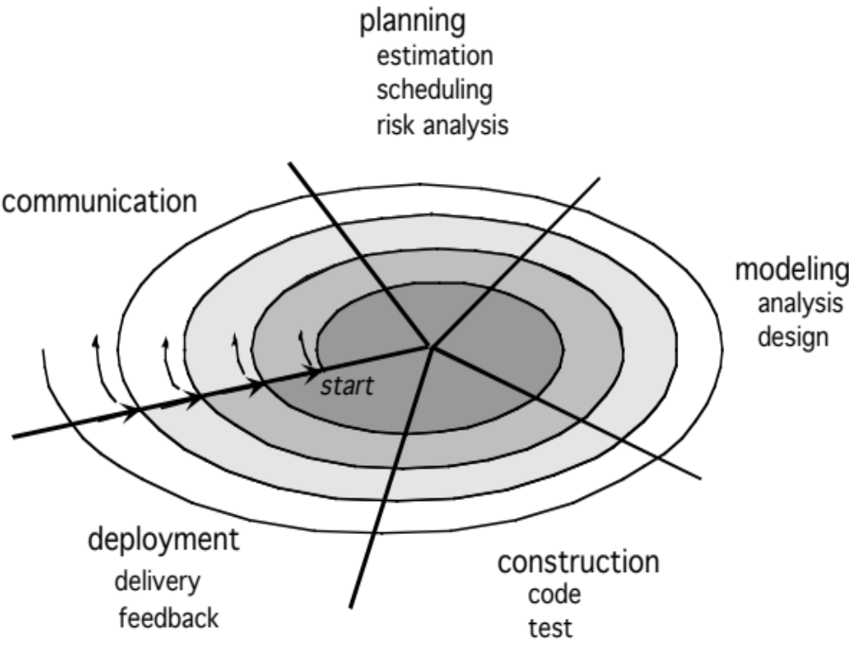
Evolutionary Models: The Spiral

Slide 23
Three Concerns on Evolutionary Processes
First concern is that prototyping poses a problem to project planning because of the uncertain number of cycles required to construct the product.
Second, it does not establish the maximum speed of the evolution. If the evolution occur too fast, without a period of relaxation, it is certain that the process will fall into chaos. On the other hand if the speed is too slow then productivity could be affected.
Third, software processes should be focused on flexibility and extensibility rather than on high quality. We should prioritize the speed of the development over zero defects. Extending the development in order to reach high quality could result in a late delivery of the product when the opportunity niche has disappeared.

Slide 24

The Unified Process (UP)
elaboration
inception

Slide 25
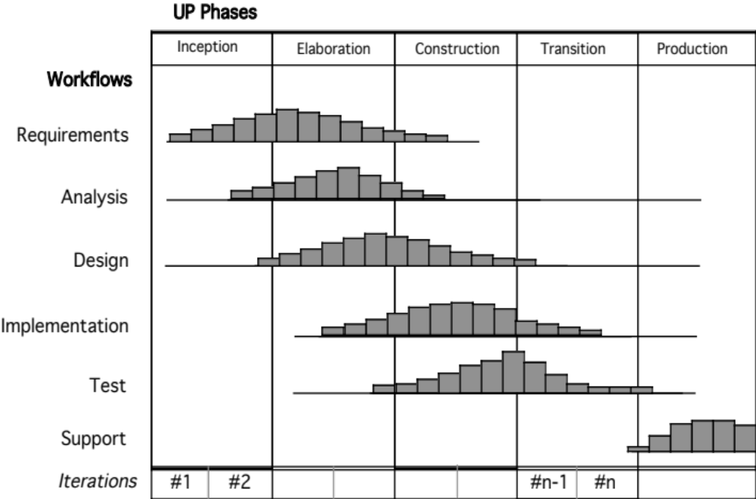
UP Phases

Slide 26
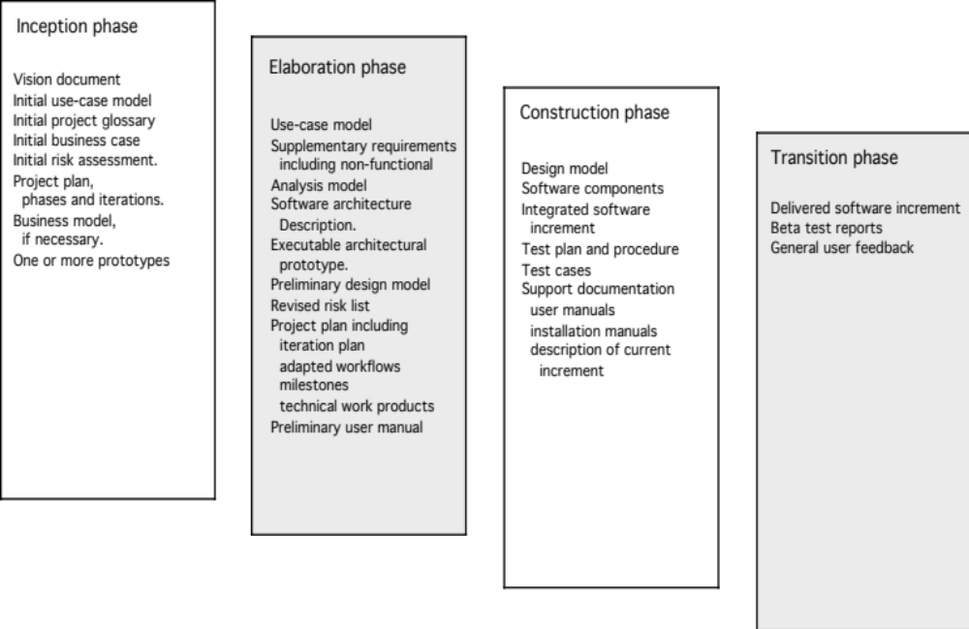
UP Work Products

Slide 27
Reference
These slides are designed to accompany Software Engineering: A Practitioner’s Approach, 7/e (McGraw-Hill, 2009). Slides copyright 2009 by Roger Pressman.
Chapter 3: Process Models
Software Engineering; A Practitioner’s Approach, 6th edition, Roger Pressman, McGraw-Hill

